Slide 1
Introduction to Java for C++ Programmers
Discovering Java Collections Framework and Iterators
Professor: Reza Khojasteh

Slide 2
Java Collection Framework
Collection is an object that contains a group of objects or groups multiple elements into a single unit; sometimes it is called data structure.
Collection Framework is a unified architecture for representing and manipulating collections (it’s composed of interfaces, implementations, and algorithms.)

Slide 3
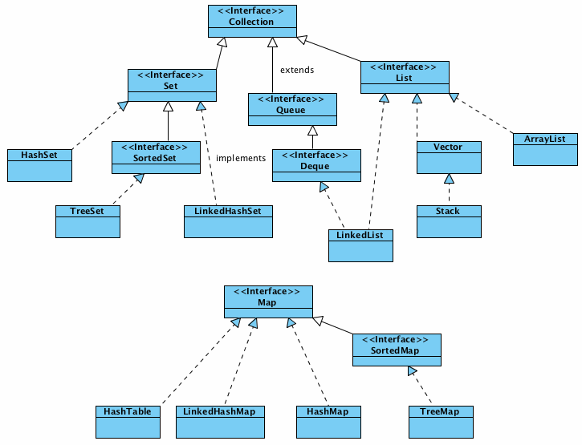
High level view of Core Collection Interfaces and classes
Notes:
Picture from: http://javastudy.ru/interview/collections/

Slide 4
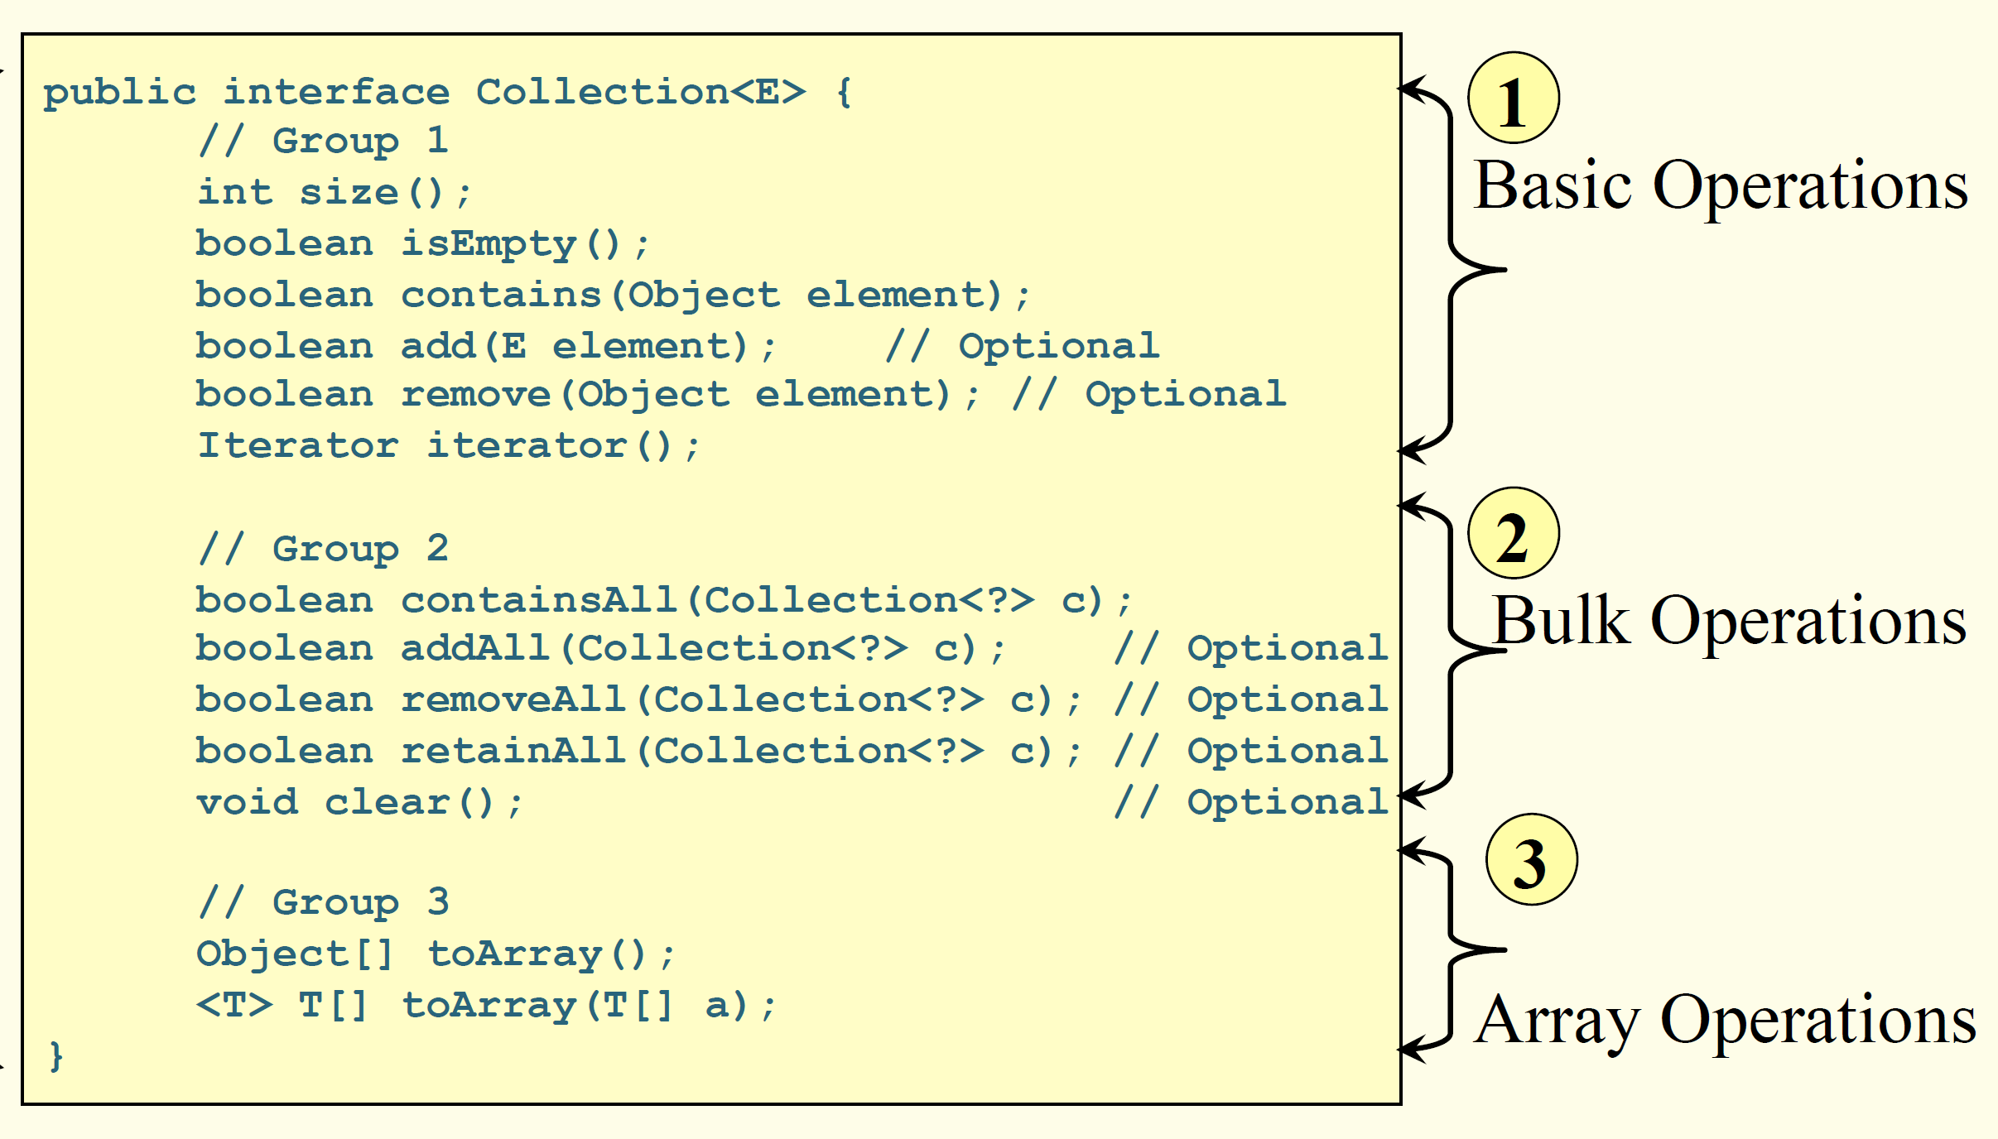
The Collection<E> Interface
Notes:
Picture from: http://javastudy.ru/interview/collections/

Slide 5
An example of using Java Collections and Iterators
ArrayList is probably the simplest collection; while array is a fixed-size collection of the objects with the same type stored sequentially, ArrayList<E> is a resizable array.
Check FilterStudents project to see an example of how to iterate over a Collection using the Iterator interface and why we’d better use iterators while traversing collections.

Slide 6
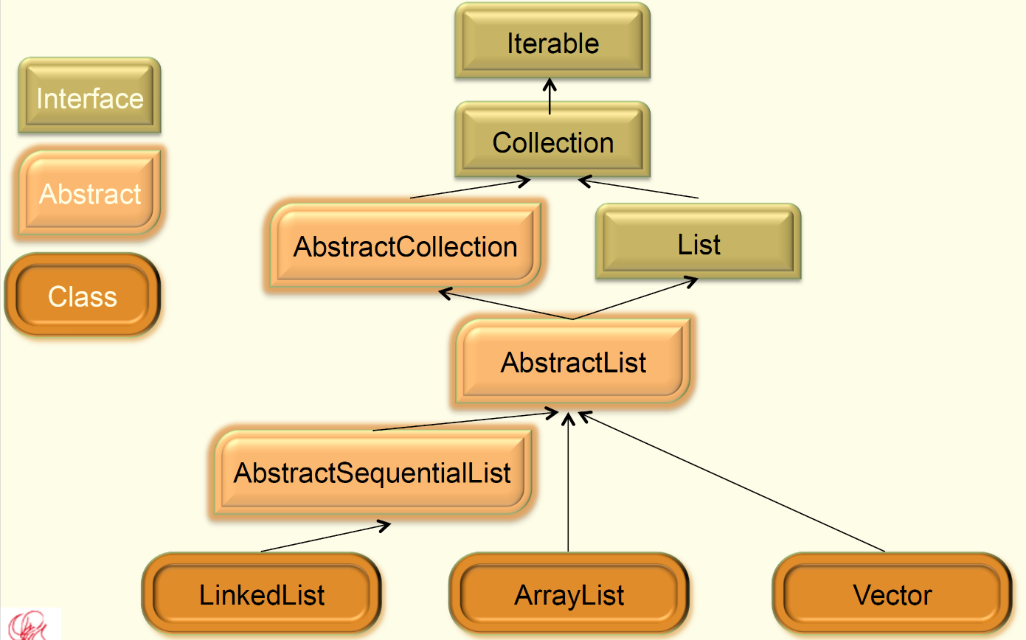
List
List is an ordered collection:

Slide 7
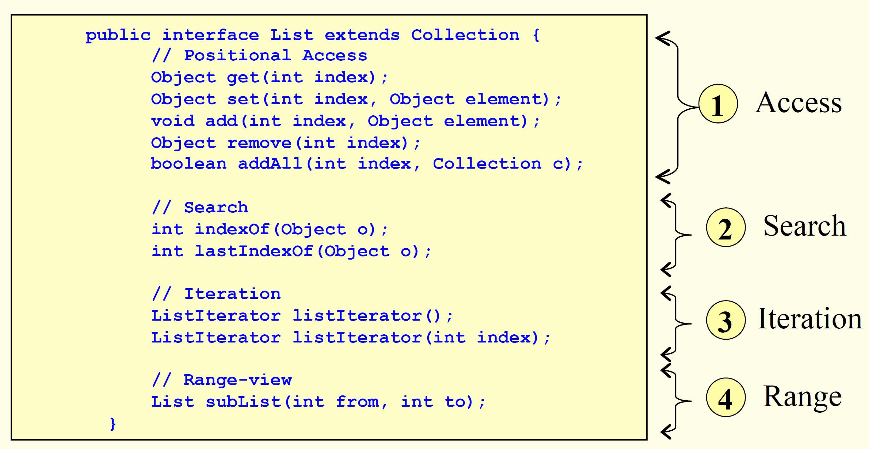
The List<E> Interface
Notes:
Picture from: http://javastudy.ru/interview/collections/

Slide 8
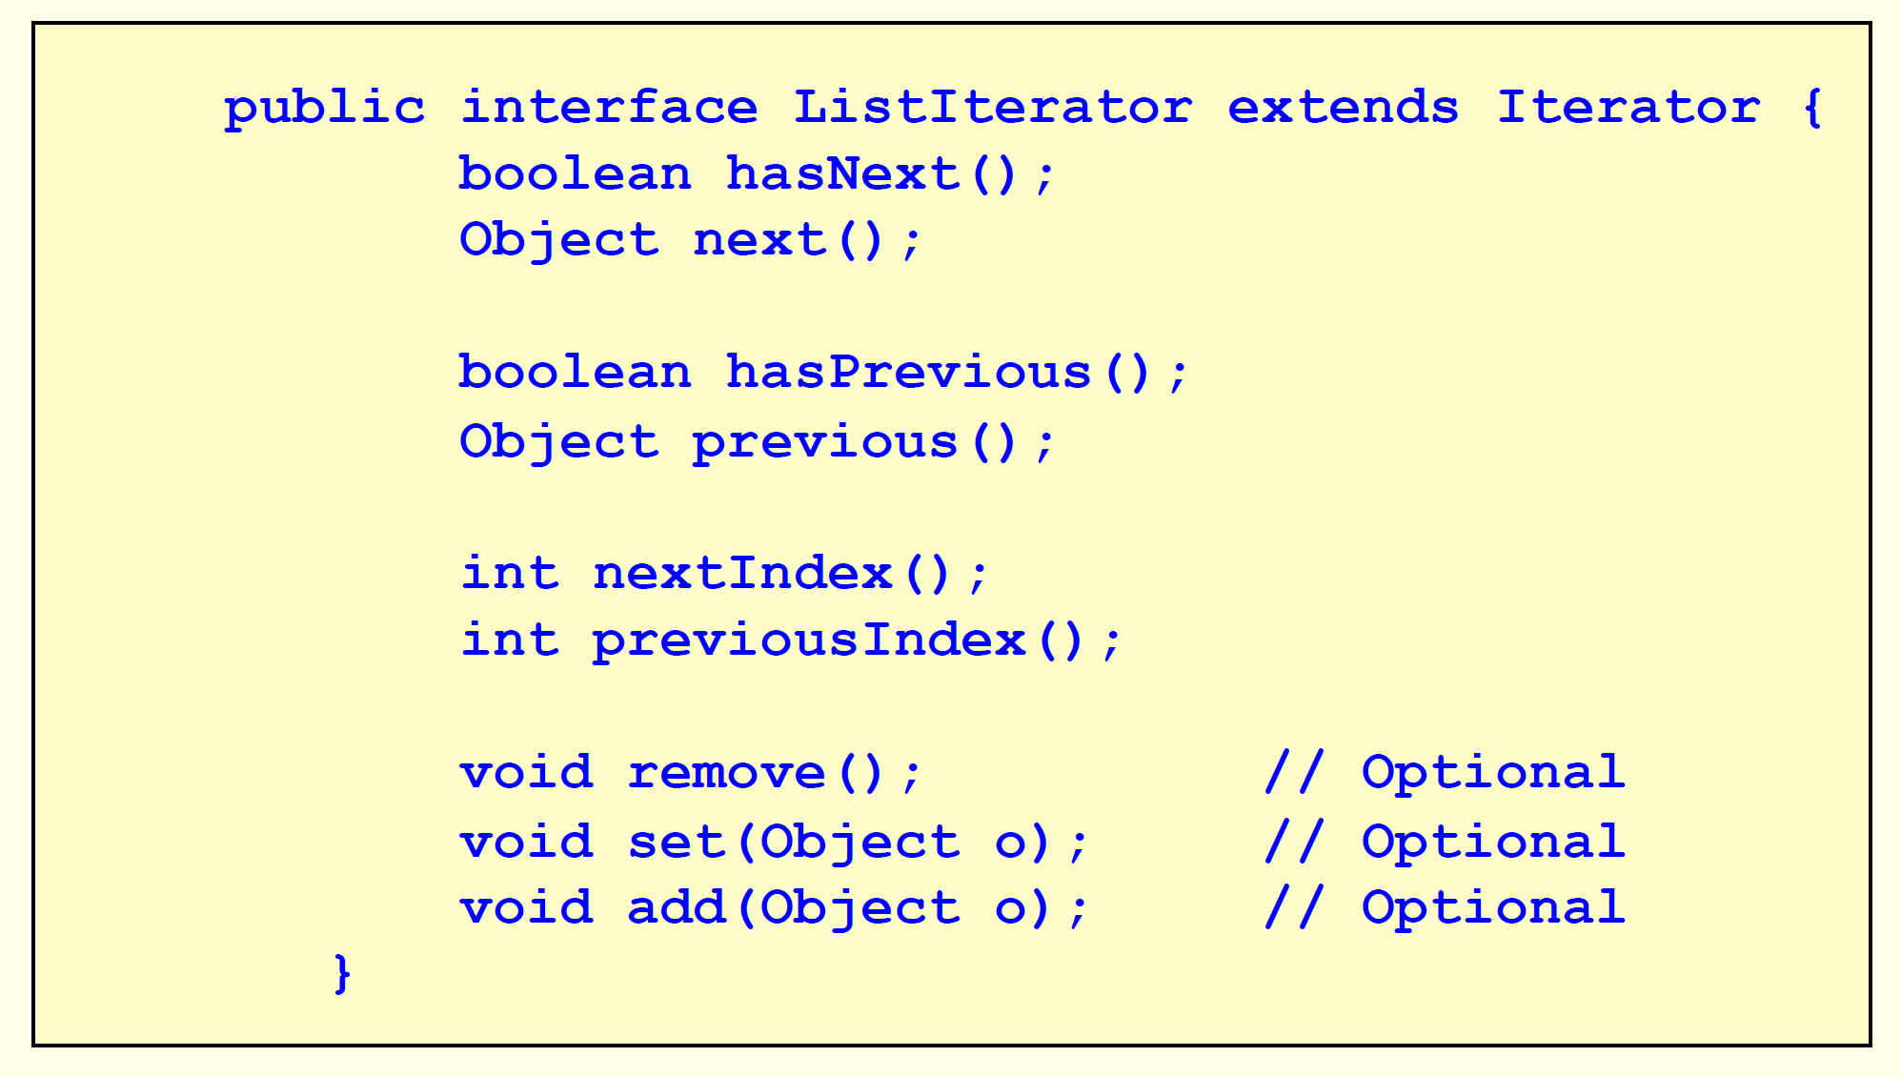
The ListIterator<E> Interface
Notes:
Picture from: http://javastudy.ru/interview/collections/

Slide 9
Some Points on Lists
Lists (like Java arrays) are zero based, but a list does not have a fixed-size (check ListExample.java)
It is possible to create a list from an array:
List<String> listofStrings = Arrays.asList("first", "second", "third");
It is possible to print the list contents using toString() method.

Slide 10
Filtering A List
In order to find out what elements in a List satisfy a condition, you could filter list elements by iterating the list and choosing only the elements that satisfy the imposed condition.
For instance, if you want to have a List with strings shorter than 6, you could write:
List<String> shorterThanSix = new ArrayList<>(0); for (String s : listofStrings) if (s.length() < 6) shorterThanSix.add(s);
Hint: using iterators is a better approach!

Slide 11
Modifying A List
In order to modify all the elements of a list, you could iterate the list and change the elements of the collection, one at the time.
For instance, if you want all your elements from the list of strings to have “Book” at the end, you could write:
List myBooks = new ArrayList(0); for (String s : listofStrings) myBooks.add(s + "Book");
Hint: not using raw types and using iterators is a better approach!

Slide 12
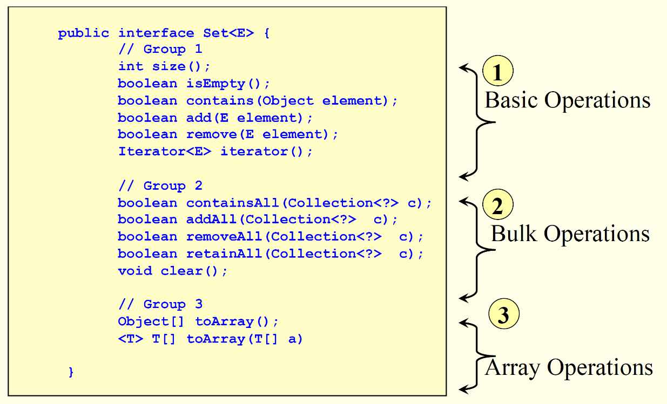
Set
Set is a collection that cannot contain duplicate elements.
Check FindDistinct.java

Slide 13
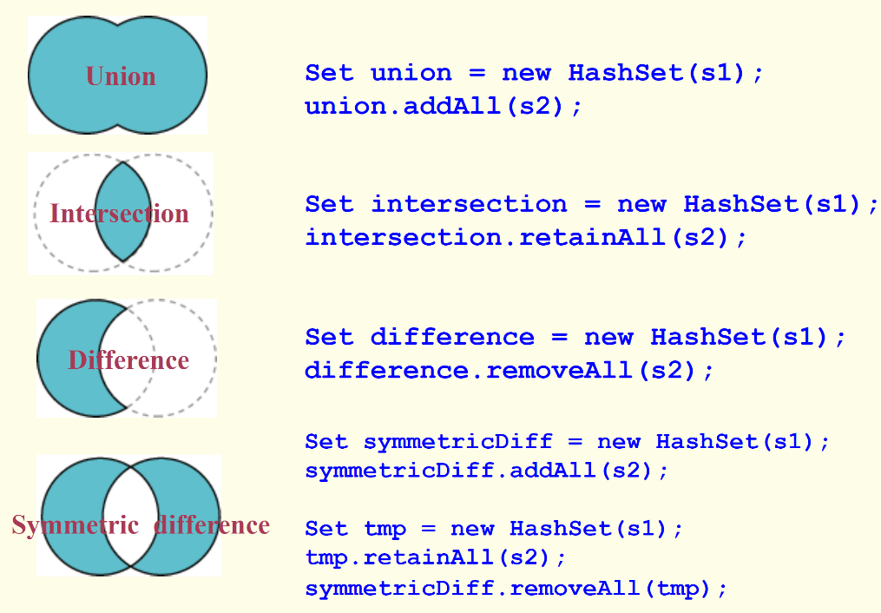
Bulk Operations on Sets
Set is a collection that cannot contain duplicate elements.
Check FindUnique.java

Slide 14
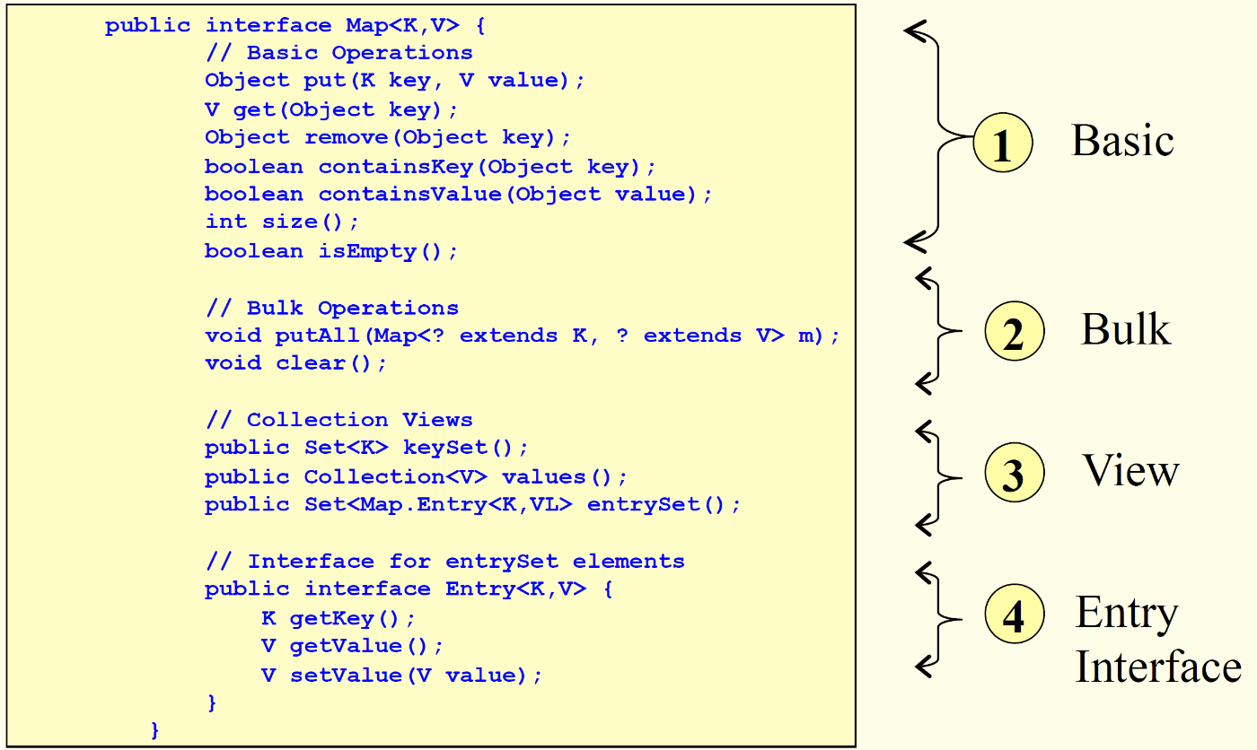
Map
Map is an object that maps keys to values.

Slide 15
Some Points on Maps
A Map cannot contain duplicate keys (the collection of keys is a set.)
Each key can map to at most one value (mathematical function abstraction.)
keySet method returns the Set of keys contained in the Map.
entrySet method returns the Set of key-value pairs contained in the Map (the Map interface has a nested interface called Map.Entry) which could be used for iterating over key-value pairs: Check Rate.java.

Slide 16
Objects Ordering and Comparable Types
Elements that can be compared to one another are called mutually comparable.
There are two main Interface types which enable you to compare objects.
Comparable interface has a compareTo method which returns a negative integer, zero, or a positive integer depending on whether this object is less than, equal to, or greater than the specified object (check AlphabeticalStudents.java)

Slide 17
Objects Ordering and Comparable Types – Cont’d
Comparator interface defines a comparison function (compare method) which imposes a total ordering on some collection of objects.
Compare method compares its two arguments for order and returns a negative integer, zero, or a positive integer as the first argument is less than, equal to, or greater than the second (check CollegeStudent.java)

Slide 18
Some Other Examples on Objects Ordering
In the Examples project:
Check OperatingSystem.java, ExampleComparable.java, and ExampleComparator.java
You could also check ExampleCollections.java and ExampleArrays.java

